Slide 1
UpX Academy – Airlines Project
Bangalore Team
March 2017 Batch : Submitted May 2017
Notes:
This template can be used as a starter file to give updates for project milestones.
Sections
Right-click on a slide to add sections. Sections can help to organize your slides or facilitate collaboration between multiple authors.
Notes
Use the Notes section for delivery notes or to provide additional details for the audience. View these notes in Presentation View during your presentation.
Keep in mind the font size (important for accessibility, visibility, videotaping, and online production)
Coordinated colors
Pay particular attention to the graphs, charts, and text boxes.
Consider that attendees will print in black and white or grayscale. Run a test print to make sure your colors work when printed in pure black and white and grayscale.
Graphics, tables, and graphs
Keep it simple: If possible, use consistent, non-distracting styles and colors.
Label all graphs and tables.

Slide 2
Project Overview
Team
Airlines Dataset
Exploratory Data Analytical questions
Business Insights gained
Notes:
What is the project about?
Define the goal of this project
Is it similar to projects in the past or is it a new effort?
Define the scope of this project
Is it an independent project or is it related to other projects?
* Note that this slide is not necessary for weekly status meetings

Slide 3
Team
The project team consisted of :
Girish Pujar
Rajiv Ramanjani
Tanguturu Anjan Vijaya Kumar
Satish Godavarthi
Jayashree
Sujit
Vybhav
Praveen
Constance
Kiran
Notes:
* If any of these issues caused a schedule delay or need to be discussed further, include details in next slide.

Slide 4
Description of the Airlines Dataset
The Airlines Dataset consisted of data organized by the following fields:
Year, Month, Day, Departure Time, Scheduled Departure Time, Departure Delay, Arrival Time, Scheduled Arrival Time, Arrival Delay, Carrier, Flight, Tail Number, Origin, Destination, Air Time, Distance, Hour, Minute, Time Hour
Notes:
Duplicate this slide as necessary if there is more than one issue.
This and related slides can be moved to the appendix or hidden if necessary.

Slide 5
Exploratory Questions around Data Set
Which origin airport has the highest number of flights? How does it compare to other airports - over each quarter in the year
Which Airport has the highest arrival and departure delay and what is the comparison with other airports?
Which airline has the highest number of flights? How does it compare to other airlines across each of the four quarters?
Which Carrier has highest delay?
What is the departure delays by carrier in EWR airport?
What month of the year do maximum number of flights depart?
Which month of the year sees maximum delays?
What time/hour of day do maximum number of flights depart?
Which hour of the day sees most delays?
Which tail number is used most by an airline? How does it compare with other airlines?
Which airline has flights that cover maximum? How does it compare to other airlines in different distance segments?
Top Eight Destinations with the lowest and highest arrival delays
Notes:
The following slides show several examples of timelines using SmartArt graphics.
Include a timeline for the project, clearly marking milestones, important dates, and highlight where the project is now.

Slide 6
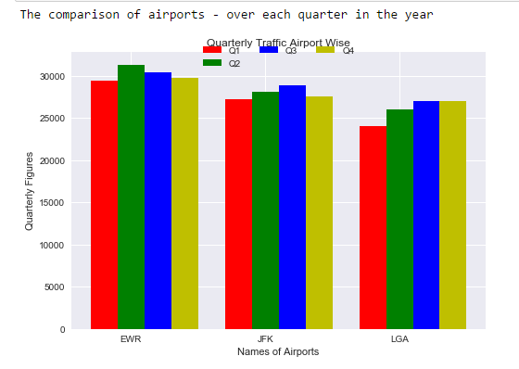
Origin airport with highest number of flights across four quarters
Insight: Newark Liberty International Airport (EWR) has the highest traffic across all four quarters

Slide 7
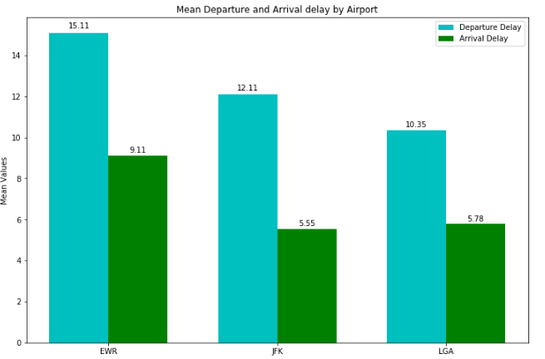
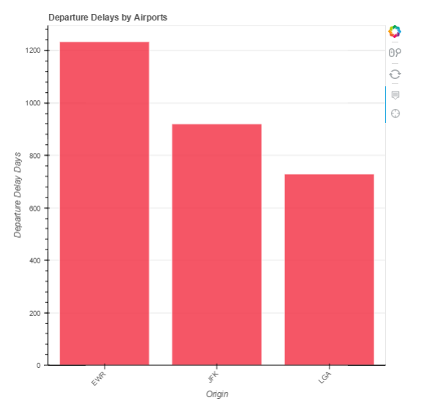
Airport with the highest arrival and departure delay and comparison with other airports
Insight:The Newark Liberty International Airport (EWR) has the highest arrival and departure delays – followed by John F Kennedy and then LaGuardia Airport

Slide 8
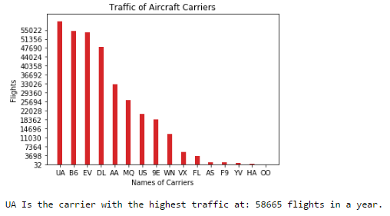
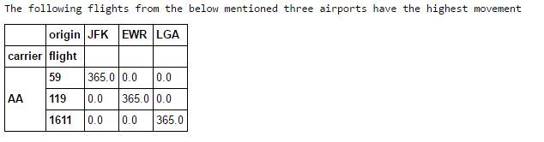
Carrier Traffic
Insight: While UA, B6, EV and DL carriers have the highest number of flights totally; specific flights that have the highest number of movement is for AA carrier with flight numbers 59, 119 and 1611 travelling daily from JFK, EWR and LGA airports

Slide 9
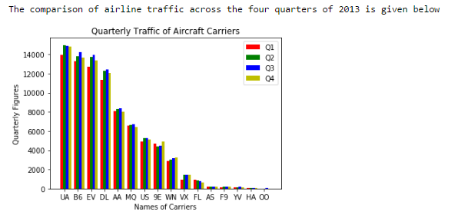
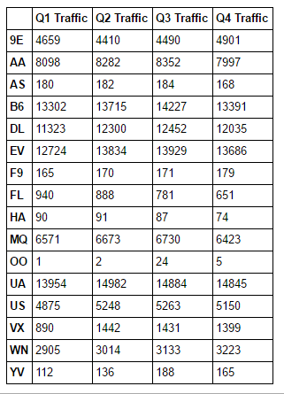
Airline traffic by carrier – across all four quarters
Insight: Carriers UA, B6, EV and DL have the highest traffic across all four quarters. Also Q1 seems to be lowest in terms of traffic. It could be due to lean tourist traffic as it comes after a peak vacation season (Q4) and before another peak season (Q2)

Slide 10
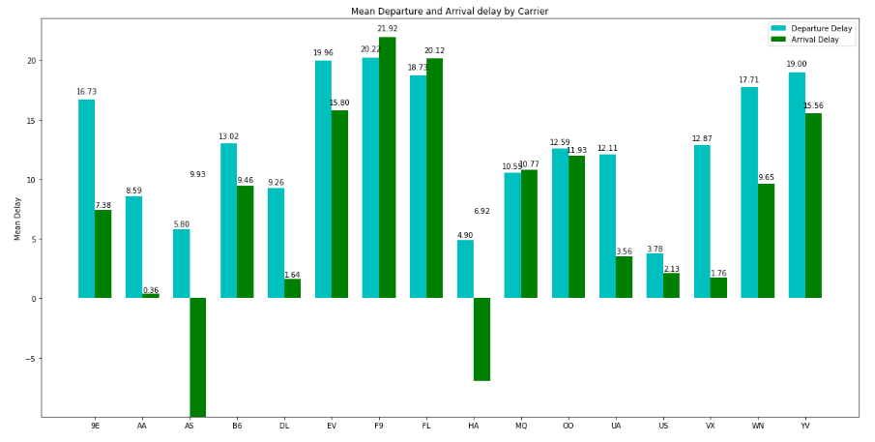
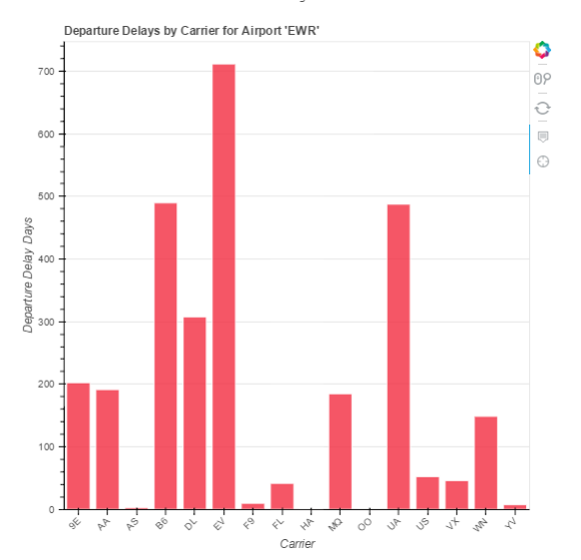
Carriers with highest delays
Insight: Carriers EV, F9, FL and YV have the highest delays whereas AS and HA airlines have the least delays. In EWR airport EV carrier has highest delays

Slide 11
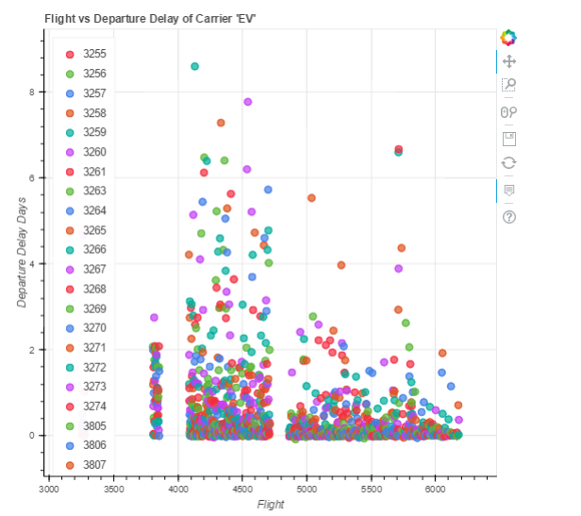
Trends for EV carrier

Slide 12
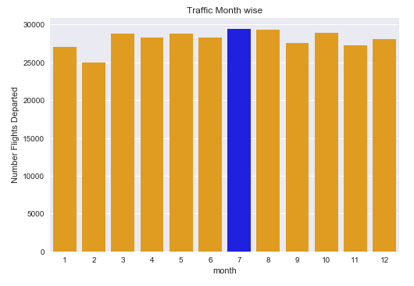
Traffic across all months in the year
Insight: As we can see July is the month with the highest traffic

Slide 13
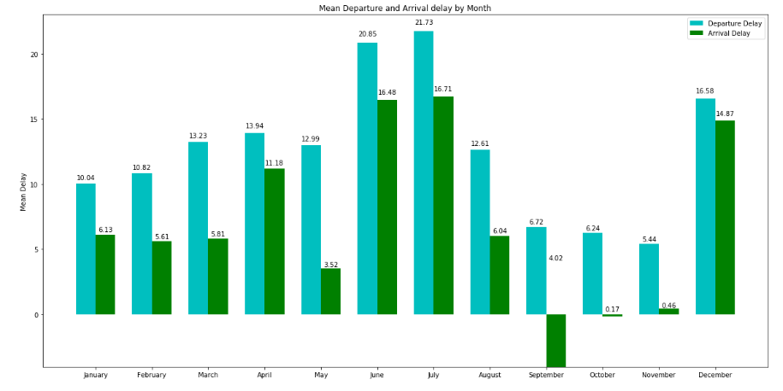
Month of the year with maximum delays
Insight: June, July and December seem to be the months with the highest delays. This could have to do with the fact that it is the peak vacation season in US

Slide 14
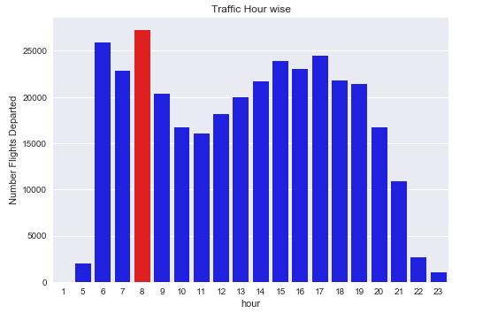
Traffic across all hours of the day
Insight: Morning 8 am is the hour with the highest traffic, followed by 6 am and then 5 pm

Slide 15
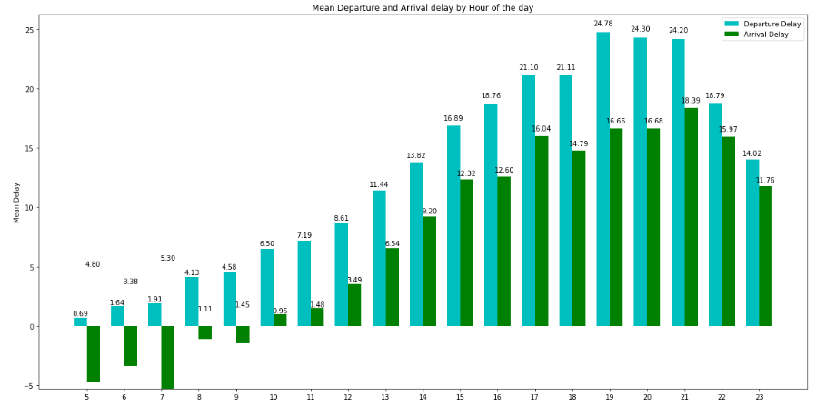
Hour of the day with most delays
Insight: Evening 1900 hrs is the time of the day with peak departure delays. This could have to do with the fact that traffic is very high as people could be leaving from work at that time of day

Slide 16
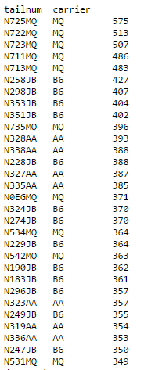
Tail numbers with highest movement
Insight: MQ and B6 carriers have the highest usage of the same tail number.

Slide 17
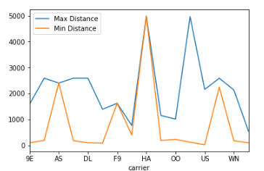
Airline flights that cover maximum distance
Insight: The HA carrier covers the maximum distance

Slide 18
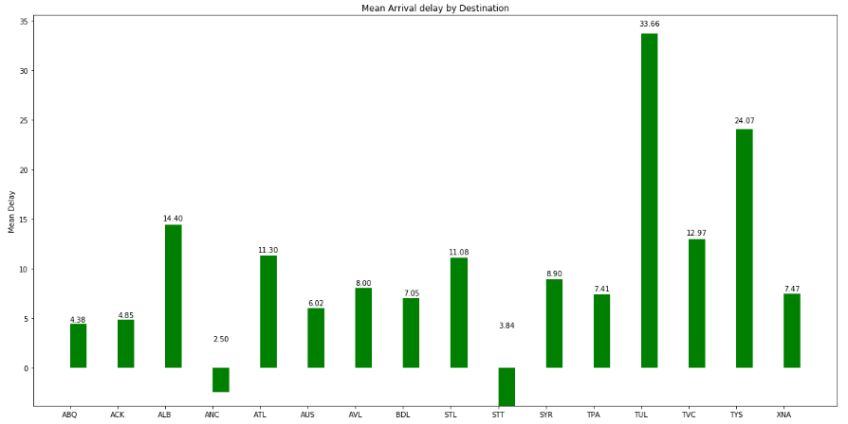
Arrival delays by destination
Insight: TUL, TVC and TYS are destinations with the highest arrival delay whereas ANC and STT are performing very well with least delay

Slide 19
Overall Insights
EWR : Newark Liberty International airport has the highest traffic followed by JFK and LGA. Consequently the airport with the highest departure and arrival delays is EWR followed by JFK and LGA
EWR airport can start addressing the delay issues by first looking at carriers EV, B6, UA and DL and try to focus on these carriers to improve their departure delay times
All three airports can be better organized to anticipate more traffic in July as that is the time of the year with the highest traffic and highest delays as well. This is followed by June and December with next highest delays. By being better prepared they can reduce delays during these times of the year
Also an anomaly seems to be that although 8 am seems to be the time with highest traffic – the hour of the day with highest delay is 7 pm. The delay trend starts at 5 pm and ends at 9 pm – while peaking at 7 pm. The reason for this anomaly could not be evidenced in the data and this needs more analysis
Carriers UA and B6 – although having the highest number of traffic in a year – seem to be having a reasonably healthy delay time as compared to carriers EV, F9, FL and YV. There could be some best practices that the later could learn from the former in terms of controlling their delay times. Having said that B6 and UA don’t seem to be contributing well to the EWR airports overall delay times. EWR itself needs to do some deep dive as the reasons could be beyond the airlines control.

Slide 20
Advice to Travelers
For travelers who are particular about time and delays – can avoid hours 1700 to 2100 to travel.
They can also avoid months June, July and December if possible.
The best airport to consider to avoid delays is LGA.
Avoid carriers EV, F9, FL and YV that have the highest delays whereas consider AS and HA airlines. Airlines with a lot of flights/experience and with a reasonably healthy delay are carriers UA and B6.

Slide 21
Resources
White Paper on Airlines delays in New York Airports:
https://www.oig.dot.gov/sites/default/files/NY%20Delays%20Final.pdf
White Paper synopsis for airlines delays are:
Various factors have contributed to this problem, the three principal causes are
A small and densely occupied airspace,
Limited capacity among the region’s three main airports, and
Continued growth in air traffic.

